Slide 1
GIS应用开发
Developing GIS Applications with ArcObjects using C#.NET
江西省研究生优质课程
主讲：兰小机 GIS博士、教授
Email : landcom8835@163.com
QQ ：305333315
      课件： ftp://218.87.136.94/

Slide 2
Chap.7 空间数据管理(5学时)
本章内容：
  GeoDatabase的基础知识
  Workspace及相关对象
  Dataset对象
  表、对象类和要素类
  ROW，Object 和 Feature 对象

Slide 3
8.1 GeoDatabase的基础知识
在AO（AE）中，各种类型的空间数据都采用统一的对象模型— Geodatabase数据模型进行操作。

Slide 4
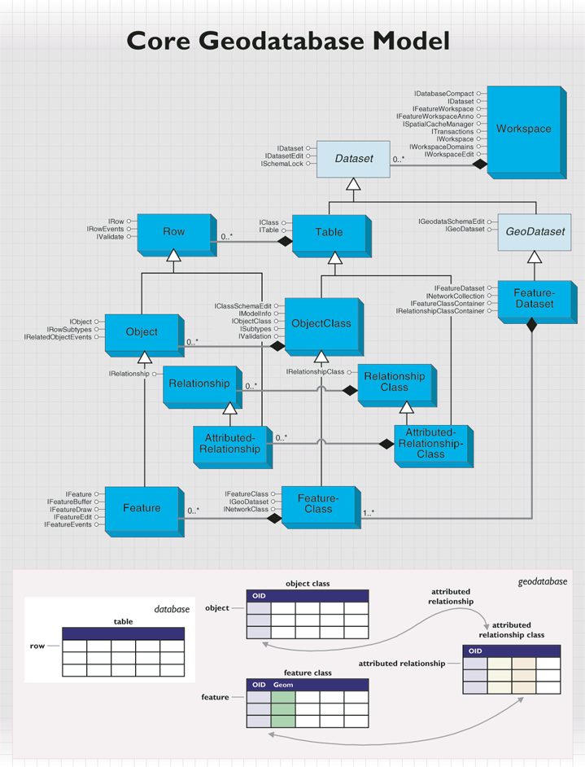

Slide 5
8.2 Workspace及相关对象
在Geodatabase数据模型中，一个工作空间对应于一个geodatabase 或一个ArcInfo coverage工作空间或一个文件夹（内有地理数据文件）。工作空间是空间数据集与非空间数据集的容器。
由esriWorkspaceType枚举类型指定的Workspace有三种类型：
  esriFileSystemWorkspace：基于文件类型的Shapefiles和ArcInfo 的工作空间
  esriLocalDatabaseWorkspace：Personal/File geodatabase
  esriRemoteDatabaseWorkspace： ArcSDE geodatabase

Slide 6
其它 workspace 类型包括：
  Raster Workspace: A workspace containing Grids and Images.
  Tin Workspace: A workspace containing TINs.
  CAD Workspace: A workspace containing CAD drawings.
  VPF Workspace: A workspace containing VPF data.

Slide 7
要操作各种类型的空间数据，首先要获得空间数据所在的工作空间。Workspace（工作空间）是一个普通类（Class），这意味着用户不能直接新建它。为了获得一个工作空间，需要使用WorkspaceFactory对象来创建或打开一个Workspace。
WorkspaceFactory是GeoDatabase的入口。它是一个抽象类，派生了很多的子类，例如SdeWorkspaceFactory， AccessWorkspaceFactory， ShapefileWorkspaceFactory ， FileGDBWorkspaceFactory等。不同类型的空间数据需要不同的工作空间工厂对象来打开一个工作空间。

Slide 8
Classes that implement IWorkspaceFactory
Classes
AccessWorkspaceFactory (esriDataSourcesGDB)
AMSWorkspaceFactory (esriTrackingAnalyst)
ArcInfoWorkspaceFactory (esriDataSourcesFile)
CadWorkspaceFactory (esriDataSourcesFile)
ExcelWorkspaceFactory (esriDataSourcesOleDB)
FileGDBWorkspaceFactory (esriDataSourcesGDB)
GeoRSSWorkspaceFactory (esriDataSourcesFile)
IMSWorkspaceFactory (esriGISClient)
InMemoryWorkspaceFactory (esriDataSourcesGDB)
NetCDFWorkspaceFactory (esriDataSourcesNetCDF)
OLEDBWorkspaceFactory (esriDataSourcesOleDB)
PCCoverageWorkspaceFactory (esriDataSourcesFile)
PlugInWorkspaceFactory
RasterWorkspaceFactory (esriDataSourcesRaster)
SDCWorkspaceFactory (esriDataSourcesFile)
SdeWorkspaceFactory (esriDataSourcesGDB)
ShapefileWorkspaceFactory (esriDataSourcesFile)
SqlWorkspaceFactory (esriDataSourcesGDB)
StreetMapWorkspaceFactory (esriDataSourcesFile)
TextFileWorkspaceFactory (esriDataSourcesOleDB)
TinWorkspaceFactory (esriDataSourcesFile)
ToolboxWorkspaceFactory (esriGeoprocessing)
VpfWorkspaceFactory (esriDataSourcesFile)

Slide 9
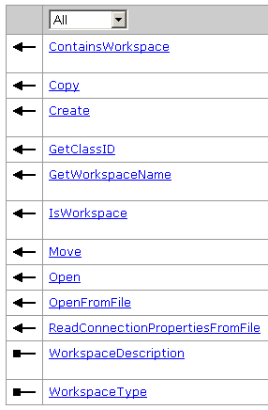
IWorkspaceFactory
IWorkspaceFactory接口定义了所有工作空间工厂对象的一般属性和方法，用户可以通过它管理不同类型的工作空间。

Slide 10
使用 IWorkspaceFactory::Create方法可以用于产生一个新的工作空间名称对象。
  public IWorkspaceName Create ( string parentDirectory, string Name, IPropertySet ConnectionProperties, int hWnd );
IWorkspaceFactory::Open方法和 IWorkspaceFactory::OpenFromFile方法可以用于打开一个已经存在的工作空间。
  public IWorkspace Open ( IPropertySet ConnectionProperties, int hWnd);
  public IWorkspace OpenFromFile ( string fileName, int hWnd);
IWorkspaceFactory::WorkspaceType属性可以返回工作空间的类型。

Slide 11
8.2.1 How to create new geodatabases
Creating a personal geodatabase workspace stored in Access
  private IWorkspace CreateAccessWorkspace ()
  { IWorkspaceFactory pAccessWorkspaceFactory = new AccessWorkspaceFactoryClass();
    IWorkspaceName pWorkspaceName = pAccessWorkspaceFactory.Create(@"d:\temp", "test.mdb", null, 0);
    ESRI.ArcGIS.esriSystem.IName name = (IName) pWorkspaceName ;
    IWorkspace pGDB_Wor = (IWorkspace )name.Open();
    return pGDB_Wor ;
  }

Slide 12
Creating a file geodatabase workspace
  // Create a file geodatabase workspace factory.
  IWorkspaceFactory workspaceFactory = new FileGDBWorkspaceFactoryClass();
  // Create a new file geodatabase.
  IWorkspaceName workspaceName = workspaceFactory.Create("C:\\temp\\", "MyFGDB.gdb", null, 0);
  IName name = (IName)workspaceName;
  //Open a reference to the file geodatabase workspace through the name object.
  IWorkspace fGDB_Wor = (IWorkspace)name.Open();

Slide 13
public static IWorkspace CreateFileGdbWorkspace(String path)
  {
  Type factoryType = Type.GetTypeFromProgID("esriDataSourcesGDB.FileGDBWorkspaceFactory");
  IWorkspaceFactory workspaceFactory = (IWorkspaceFactory) Activator.CreateInstance(factoryType);
  IWorkspaceName workspaceName = workspaceFactory.Create(path, "Sample.gdb", null, 0);
  IName name = (IName) workspaceName;
  IWorkspace workspace = (IWorkspace) name.Open();
  return workspace;
  }

Slide 14
Creating a connection file (.sde) to an Enterprise ArcSDE workspace
public IWorkspaceName open_ArcSDE_Workspace (string server, string instance, string user,string password, string database, string version)
  { IPropertySet propertySet = new PropertySetClass();
  propertySet.SetProperty("SERVER", server);
  propertySet.SetProperty("INSTANCE", instance);
  propertySet.SetProperty("DATABASE", database);
  propertySet.SetProperty("USER", user);
  propertySet.SetProperty("PASSWORD", password);
  propertySet.SetProperty("VERSION", version);
  IWorkspaceFactory2 workspaceFactory = (IWorkspaceFactory2) new SdeWorkspaceFactoryClass();
  return workspaceFactory.Create("d:\\temp\\", "myconnection.sde", propertySet, 0);
  }

Slide 15
Creating a geodatabase in a personal or workgroup ArcSDE workspace
  // Create a data server manager object.
  IDataServerManager dataserverManager = new DataServerManagerClass();
  // Set the server name and connect to the server.
  dataserverManager.ServerName = "tivo\\sqlexpress";
  dataserverManager.Connect();
  // Open one of the geodatabases in the database server.
  IDataServerManagerAdmin dataservermanagerAdmin = (IDataServerManagerAdmin)dataserverManager;
  IWorkspaceName workspaceName = dataservermanagerAdmin.CreateWorkspaceName("sewer", "VERSION", "dbo.Default");
  IName name = (IName)workspaceName;
  IWorkspace GDB_wor = (IWorkspace)name.Open();

Slide 16
8.2.2 How to connect to a geodatabase
The hWnd argument is the parent window or application's window. The hWnd will guarantee that the connection dialog, if presented to you because of insufficient properties, has the correct parent.
有3种不同的方法打开工作空间：
  IWorkspaceFactory.Open
    public IWorkspace Open ( IPropertySet ConnectionProperties, int hWnd);
  IWorkspaceFactory.OpenFromFile
    public IWorkspace OpenFromFile ( string fileName, int hWnd);
  IWorkspaceFactory2.OpenFromString
    public IWorkspace OpenFromString ( string connectStr, int hWnd );
    The connect string is a collection of name value pairs separated by a semicolon (;).
    the pathname of a file or directory that represents either a FileSystemWorkspace or LocalDatabaseWorkspace, or a connection file to a RemoteDatabase workspace

Slide 17
（1）打开Personal GeoDatabae数据库
//For example, database = "C:\\myData\\mypGDB.mdb".
  public IWorkspace open_pGDB_Workspace(string database)
  { IPropertySet propertySet = new PropertySetClass();
  propertySet.SetProperty("DATABASE", database);
  IWorkspaceFactory workspaceFactory = new AccessWorkspaceFactoryClass();
  return workspaceFactory.Open(propertySet, 0);
  }
  public IWorkspace Open ( IPropertySet ConnectionProperties, int hWnd );

Slide 18
//For example, fileName = "C:\\myData\\mypGDB.mdb".
  public IWorkspace openFromFilepGDBWorkspace(string fileName)
  { IWorkspaceFactory workspaceFactory = new AccessWorkspaceFactoryClass();
  return workspaceFactory.OpenFromFile(fileName, 0);
  }
  public IWorkspace OpenFromFile ( string fileName, int hWnd );
//For example, connectionString = "DATABASE=C:\\myData\\mypGDB.mdb".
  public IWorkspace openFromStringpGDBWorkspace(string connectionString)
  { IWorkspaceFactory2 workspaceFactory = (IWorkspaceFactory2)new AccessWorkspaceFactoryClass();
  return workspaceFactory.OpenFromString(connectionString, 0);
  }
  public IWorkspace OpenFromString ( string connectStr, int hWnd );
  "SERVER=myServer;DATABASE=sde;INSTANCE=5151;USER=Editor;PASSWORD=Editor;VERSION=SDE.DEFAULT"

Slide 19
（2）Connecting to a file geodatabase workspace
//For example, database = "C:\\myData\\myfGDB.gdb".
  public IWorkspace open_fGDB_Workspace(string database)
  { IPropertySet propertySet = new PropertySetClass();
  propertySet.SetProperty("DATABASE", database);
  IWorkspaceFactory workspaceFactory = new FileGDBWorkspaceFactoryClass();
  return workspaceFactory.Open(propertySet, 0);
  }
  public IWorkspace Open ( IPropertySet ConnectionProperties, int hWnd );

Slide 20
//For example, fileName = "C:\\myData\\myfGDB.gdb".
  public IWorkspace openFromFile_fGDB_Workspace(String fileName )
  { IWorkspaceFactory workspaceFactory = new FileGDBWorkspaceFactoryClass();
  return workspaceFactory.OpenFromFile(fileName , 0);
  }
  public IWorkspace OpenFromFile ( string fileName, int hWnd );
//For example, connectionString = "DATABASE=C:\\myData\\myfGDB.gdb".
  public IWorkspace openFromString_fGDB_Workspace(string connectionString)
  { IWorkspaceFactory2 workspaceFactory = (IWorkspaceFactory2)new FileGDBWorkspaceFactoryClass();
  return workspaceFactory.OpenFromString(connectionString, 0); }
  public IWorkspace OpenFromString ( string connectStr, int hWnd );
  "SERVER=myServer;DATABASE=sde;INSTANCE=5151;USER=Editor;PASSWORD=Editor;VERSION=SDE.DEFAULT"

Slide 21
（3）Connecting to an enterprise ArcSDE geodatabase workspace
public IWorkspace open_ArcSDE_Workspace(string server, string instance, string user, string password, string database, string version)
  { IPropertySet propertySet = new PropertySetClass();
  propertySet.SetProperty("SERVER", server);
  propertySet.SetProperty("INSTANCE", instance);
  propertySet.SetProperty("DATABASE", database);
  propertySet.SetProperty("USER", user);
  propertySet.SetProperty("PASSWORD", password);
  propertySet.SetProperty("VERSION", version);
  IWorkspaceFactory workspaceFactory = new SdeWorkspaceFactoryClass(); return workspaceFactory.Open(propertySet, 0);
  }

Slide 22
（4）打开Shapefile工作空间
public IWorkspace OpenShapfileWorkspace (string Location)
  {
  IWorkspaceFactory wsf = new ShapefileWorkspaceFactoryClass();
  IWorkspace ws = wsf.OpenFromFile(Location,0);
  return ws;
  }

Slide 23
8.2.3 Workspace主要接口
  Workspace实现的主要接口如下表所示.

Slide 24
Interfaces | Description
IDatasetContainer3 | Provides access to adding datasets to the dataset container.
IFeatureWorkspace | Provides access to members that create and open various types of datasets and other workspace level objects.
IFeatureWorkspaceSchemaEdit | Provides access to altering the instance CLSID and the class extension CLSID.
ITopologyWorkspace | Provides access to members that access the topologies in a workspace.
ITransactions | Provides access to members that control Transaction management.
ITransactionsOptions | Provides access to members that control Transaction options.
IWorkspace2 | Provides access to members that have information about the workspace.
IWorkspaceConfiguration | Provides access to configuration keywords.
IWorkspaceDomains | Provides access to members that return information about domains and allows you to add or delete domains.
IWorkspaceDomains2 | Provides access to members that allow you to alter a domain.
IWorkspaceEdit | Provides access to members that control Workspace Editing.
IWorkspaceReplicaDatasets | Provides access to members that return a list of replica datasets.
IWorkspaceReplicas | Provides access to members that return objects containing information about replicas.
IWorkspaceReplicasAdmin3 | Provides access to members that modify information about a replica.

Slide 25
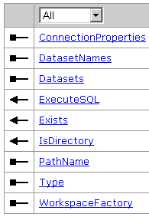
IWorkspace 接口
IWorkspace接口定义了一个工作空间最普通的属性和方法。
  ConnectionProperties返回工作空间的连接属性集对象；
  Datasets属性可以按照数据集(Dataset)的类型而返回一个数据集枚举对象；
  Type和WorkspaceFactory属性则可以分别返回工作空间的类型和工作空间工厂的种类。

Slide 26
public IEnumDataset get_Datasets ( esriDatasetType DatasetType );
  The get_Datasets method returns an enumerator over the datasets in the workspace of the specified dataset type.
  Using a dataset type of esriDTAny will return all the datasets or datasets in the workspace, across all dataset types.
    Note that only the top-level datasets in the workspace are returned by these methods. In particular, if a workspace contains both stand-alone feature classes and additional feature classes that are part of a feature dataset, then calling the get_Datasets on the workspace with a dataset type of esriDTFeatureClass will return only the standalone feature classes.

Slide 27
//拷贝数据库模式：包括属性域、要素数据集、要素类（包括要素数据集中的要素类和独立的要素类）、表
  private void CreateSchema()
  { CopyDomains(sourceWorkspace, targetWorkspace);
  IEnumDataset sourceFeatureDatasets = sourceWorkspace.get_Datasets(esriDatasetType.esriDTFeatureDataset);
  CreateFeatureDatasetsAndFeatureClasses(sourceFeatureDatasets);
  IEnumDataset featureClasses = sourceWorkspace.get_Datasets(esriDatasetType.esriDTFeatureClass);
  CreateFeatureClassesInWorkspace(featureClasses);
  IEnumDataset tables = sourceWorkspace.get_Datasets(esriDatasetType.esriDTTable);
  CreateTablesInWorkspace(tables);
  }

Slide 28
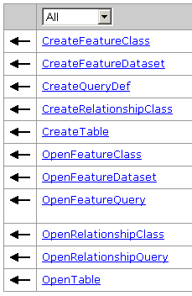
IFeatureWorkspace接口
主要用于管理基于要素的数据集，如表（Table）、对象类（ObjectClass）、要素类（FeatureClass）、要素数据集（FeatureDataset）和关系类（RelationshipClass）等。

Slide 29
private void mnuAddFeatureClassToMap_Click(object sender, System.EventArgs e)
  {
  IWorkspaceFactory wsf = new ShapefileWorkspaceFactoryClass();
  IFeatureWorkspace pFeatWorkspace = wsf.OpenFromFile(@"D:\ArcTutor\usa",0) as IFeatureWorkspace;
  IFeatureClass pFeatClass = pFeatWorkspace.OpenFeatureClass("counties");
  IFeatureLayer pFeatLyr = new FeatureLayerClass();
  pFeatLyr.FeatureClass = pFeatClass;
  pFeatLyr.Name = pFeatClass.AliasName;
  IMap pMap = axMapControl1.Map;
  pMap.AddLayer(pFeatLyr);
  }

Slide 30
8.2.4 PropertySet
Propertyset对象是一个专门用于设置属性的对象，它是一种 name-value对的集合。属性名必须是字符串，属性值可以是字符串、数值或日期，也可以是一个对象。属性值支持通过名字来查找属性的方法。
IWorkspaceFactory::Open方法要求用 Propertyset（属性集合）来打开一个 Workspace。

Slide 31
如打开一个 SDE数据库的时候，进行如下配置：
  IPropertySet pPropertyset = new PropertySetClass();
  pPropertyset.SetProperty("Server", "data") ; //服务器
  pPropertyset.SetProperty("Instance", "esri_sde"); //SDE实例
  pPropertyset.SetProperty("user", "sde") ; //SDE数据库的用户名
  pPropertyset.SetProperty("password", "sde"); //SDE数据库的密码
  pPropertyset.SetProperty("version", "sde.DEFAULT"); //'默认版本

Slide 32
8.2.5 名称对象
名称（Name）对象标识并且定义了GeoDatabase对象（如数据集或者工作空间）或地图对象（如图层）。尽管名称对象只是它代表的对象的一个“代理”，但它支持程序员使用实例化的特定对象的Open方法。
下面是一个使用Open方法实例化的例子：
  IName pName = pFeatureClassName as IName;
  IFeatureClass pFeatureClass = pName.Open () as IFeatureClass;
名称对象的子类众多， 如TableName、FeatureClassName、ObjectClassName等。

Slide 33
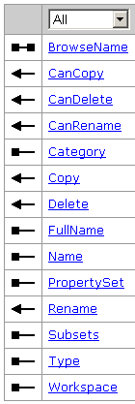
8.3 Dataset对象
Dataset（数据集）是一个代表了Workspace中所谓的数据集合的抽象类，它是一个高级别的数据容器。所有放在工作空间的对象都是一种数据集对象。
Dataset对象分为两大类
  一种是Table，可以简单看成是一张二维表，它是由一条条记录组成的，是保存Row的容器；
  一种是GeoDataset，地理数据集，如要素数据集、栅格数据集。
IDataset接口定义的属性、方法如右图所示：

Slide 34
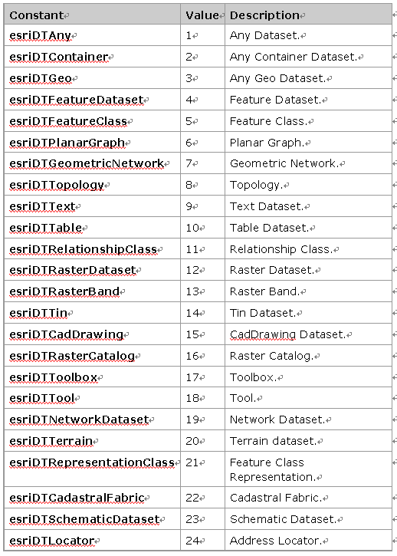
esriDatasetType Constants

Slide 35
8.3.1 GeoDataset类
GeoDataset（地理数据集）是一个抽象类，它代表了拥有空间属性的数据集。GeoDataset的例子包括要素数据集FeatureDataset、要素类FeatureClass、TIN和栅格数据集RasterDataset等。
非GeoDataset的数据集包括Table、对象类ObjectClass和关系类RelationshipClass等。

Slide 36
IGeoDataset接口定义了GeoDataset对象的空间信息，包括空间参考和范围属性。通过IGeoDataset::SpatialRefrence可以获得一个 GeoDataset对象的空间参考，IGeoDataset::Extent则可以获得要素集的定义范围。
IGeoDatasetSchemaEdit接口可以让程序员去改变一个GeoDataset的空间参考，IGeoDatasetSchemaEdit ::AlterSpatialRefrence方法重新设置与数据集关联的空间参考。这个方法多使用于给一个空间参考为Unknown的地理数据集设置空间参考。 IGeoDatasetSchemaEdit ::CanAlterSpatialReference Indicates if the spatial reference of the dataset can be altered.

Slide 37
改变一个图层的空间参考
private void AlterSpatialReferrenc( IMap pMap, IFeatureLayer featurelayer)
  { IActiveView pActiveView = pMap as IActiveView;
  IFeatureClass pFeatureClass = featurelayer.FeatureClass;
  IGeoDataset pGeoDataset = pFeatureClass as IGeoDataset;
  IGeoDatasetSchemaEdit pGeoDatasetEdit = pGeoDataset as IGeoDatasetSchemaEdit; ????????????????
  if (pGeoDatasetEdit.CanAlterSpatialReference == true)
  { ISpatialReferenceFactory2 pSpatRefFact = new SpatialReferenceEnvironmentClass();
  IGeographicCoordinateSystem pGeoSys = pSpatRefFact.CreateGeographicCoordinateSystem(4214);//esriSRGeoCSType .esriSRGeoCS_Beijing1954
  pGeoDatasetEdit.AlterSpatialReference(pGeoSys); }
  pActiveView.Refresh(); }

Slide 38


Slide 39
8.3.2 FeatureDataset对象
要素数据集对象是具有相同空间参考的要素类的容器。使用要素数据集的情况十分广泛，例如几何网络、拓扑关系必须建立在一个要素数据集中。
在工作空间中对一个要素类进行编程的时候，需要注意这个要素类放在什么地方，是直接放在工作空间中（这种要素类被称为 standalone featureclass），还是放在一个要素数据集中。当使用IWorkspace::Datasets属性来遍历一个工作空间内的数据集时，返回的只是直接放在工作空间的数据集，而保存在一个要素数据集中的要素类则不会被遍历。

Slide 40
使用 IFeatureWorkspace::OpenFeatureClass打开工作空间中的任何一个要素类，无论它是直接存放在工作空间还是存放在工作空间中的一个要素数据集中。

Slide 41

IFeatureDataset
这个接口是从IDataset接口继承而来的。
使用IFeatureDataset::CreateFeatureClass方法可以用来在要素数据集中创建一个新的要素类。这个方法和IFeatureWorkspace::CreateFeaureClass的方法类似。
新建要素类的空间参考是通过它的几何字段来设置的。

Slide 42
  IEnumDataset sourceFeatureDatasets = sourceWorkspace.get_Datasets( esriDatasetType.esriDTFeatureDataset );
private void CreateFeatureDatasetsAndFeatureClasses( IEnumDataset sourceFeatureDatasets)
  { if (sourceWorkspace == null || targetWorkspace == null) return;
  ISpatialReference spatialRference;
  sourceFeatureDatasets.Reset();
  IDataset dataset = sourceFeatureDatasets.Next();
  while (dataset != null)
  { IGeoDataset geoDataset = dataset as IGeoDataset;
  spatialRference = geoDataset.SpatialReference;
  IFeatureDataset sourceFeatureDataset = dataset as IFeatureDataset;
  IFeatureWorkspace featureWorkspace = targetWorkspace as IFeatureWorkspace;

Slide 43
public bool get_NameExists ( esriDatasetType Type, string Name );
  if ((IWorkspace2)targetWorkspace).get_NameExists (esriDatasetType. esriDTFeatureDataset, ((IDataset)sourceFeatureDataset).Name))
  dataset = sourceFeatureDatasets.Next();
  IFeatureDataset targetFeatureDataset = featureWorkspace.CreateFeatureDataset(dataset.Name, spatialRference);
  CreateFeatureClassesInDataset(sourceFeatureDataset, targetFeatureDataset);
  dataset = sourceFeatureDatasets.Next();
  } }

Slide 44
//创建要素数据集中的要素类：要素类、拓扑关系
  public void CreateFeatureClassesInDataset(IFeatureDataset sourceFeatureDataset, IFeatureDataset targetFeatureDataset)
  { if (sourceFeatureDataset == null || targetFeatureDataset == null) return;
  IEnumDataset datasets = sourceFeatureDataset.Subsets;
  IDataset sourceDataset = datasets.Next();
  while (sourceDataset != null)
  { switch (sourceDataset.Type)
  { case esriDatasetType.esriDTFeatureClass:
  if (((IWorkspace2)targetWorkspace).get_NameExists (esriDatasetType.esriDTFeatureClass, sourceDataset.Name)) break;
  IFeatureClass sourceFeatureClass = sourceDataset as IFeatureClass;
  CreateFeatureClassInThisDataset(sourceFeatureClass, targetFeatureDataset);
  break;

Slide 45
  case esriDatasetType.esriDTNetworkDataset:
  INetworkDataset sourceNetworkDataset = sourceDataset as INetworkDataset;
  CreateNetworkDataset(sourceFeatureDataset, targetFeatureDataset); break;
  case esriDatasetType.esriDTRelationshipClass:
  CreateRelationshipClassSchema(sourceFeatureDataset, targetFeatureDataset); break;
  case esriDatasetType.esriDTTopology:
  CreateTopology( sourceFeatureDataset, targetFeatureDataset); break;
  default: break;
  }
  sourceDataset = datasets.Next();
  } }

Slide 46
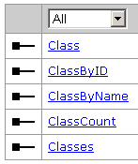
IFeatureClassContainer
IFeatureClassContainer接口用于管理要素数据集中的要素类。该接口的ClassByName和Class(index)等属性都可以用来获取数据集中的特定的要素类。
IFeatureClassContainer::ClassCount和Classes属性分别可以获得要素数据集中的要素类的数目和得到一个要素类的枚举对象。
IFeatureClassContainer::ClassByID属性可以让程序员通过对象类的ID值返回一个特定的对象类。

Slide 47
public void CreateFeatureClassesInDataset( IFeatureDataset sourceFeatureDataset, IFeatureDataset targetFeatureDataset)
  { IFeatureClassContainer sourceFeatureClassContainer = sourceFeatureDataset as IFeatureClassContainer;
  for (int i = 0; i < sourceFeatureClassContainer.ClassCount; i++)
  { IFeatureClass sourceFeatureClass = sourceFeatureClassContainer.get_Class(i);
  CreateFeatureClassInThisDataset(sourceFeatureClass, targetFeatureDataset);
  }

Slide 48
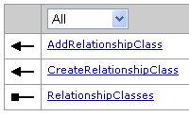
IRelationshipClassContainer接口
要素数据集中还可以存储关系类对象，可以通过这个接口来添加、新建和获得要素数据集中的关系类对象。
IRelationshipClassContainer.CreateRelationshipClass方法可以让程序员在要素数据集中产生一个新的关系类。
  public IRelationshipClass CreateRelationshipClass ( string relClassName, IObjectClass OriginClass, IObjectClass DestinationClass, string forwardLabel, string backwardLabel, esriRelCardinality Cardinality, esriRelNotification Notification, bool IsComposite, bool IsAttributed, IFields relAttrFields, string OriginPrimaryKey, string destPrimaryKey, string OriginForeignKey, string destForeignKey );

Slide 49
private void CreateRelationshipClassSchema(IFeatureDataset sourceFeatureDataset, IFeatureDataset targetFeatureDataset)
  {
  IRelationshipClassContainer fromRelClsContainer = sourceFeatureDataset as IRelationshipClassContainer;
  IRelationshipClassContainer toRelClsContainer = targetFeatureDataset as IRelationshipClassContainer;
  IFeatureWorkspace targetFeatureWorkspace = targetWorkspace as IFeatureWorkspace;
  IEnumRelationshipClass fromRelClasses = fromRelClsContainer.RelationshipClasses;
  fromRelClasses.Reset();
  IRelationshipClass fromRelClass = fromRelClasses.Next();

Slide 50
  while (fromRelClass != null)
  {
  string fromRelClsName = (fromRelClass as IDataset).Name;
  esriRelCardinality fromRelCardinality = fromRelClass.Cardinality;
  string fromFwdPathLabel = fromRelClass.ForwardPathLabel;
  string fromBwdPathLabel = fromRelClass.BackwardPathLabel;
  IObjectClass fromOriginCls = fromRelClass.OriginClass;
  string fromOriginPK = fromRelClass.OriginPrimaryKey;
  string fromOriginFK = fromRelClass.OriginForeignKey;
  IObjectClass fromDesCls = fromRelClass.DestinationClass;
  string fromDesPK = fromRelClass.DestinationPrimaryKey;
  string fromDesFK = fromRelClass.DestinationForeignKey;
  bool fromIsAttributed = fromRelClass.IsAttributed;
  bool fromIsComposite = fromRelClass.IsComposite;
  esriRelNotification fromRelNotif = fromRelClass.Notification;

Slide 51
  IObjectClass toOriginCls = null;
  if (fromOriginCls is IFeatureClass)
  toOriginCls = targetFeatureWorkspace.OpenFeatureClass(((IDataset)fromOriginCls).Name);
  else if (fromOriginCls is ITable)
  toOriginCls = targetFeatureWorkspace.OpenTable(((IDataset)fromOriginCls).Name) as IObjectClass;
  IObjectClass toDesCls = null;
  if (fromDesCls is IFeatureClass)
  toDesCls = targetFeatureWorkspace.OpenFeatureClass(((IDataset)fromDesCls).Name);
  else if (fromOriginCls is ITable)
  toDesCls = targetFeatureWorkspace.OpenTable(((IDataset)fromDesCls).Name) as IObjectClass;

Slide 52
  toRelClsContainer.CreateRelationshipClass (fromRelClsName, toOriginCls, toDesCls, fromFwdPathLabel, fromBwdPathLabel, fromRelCardinality, fromRelNotif, fromIsComposite, fromIsAttributed,null, fromOriginPK, "", fromOriginFK, "");
  fromRelClass = fromRelClasses.Next();
  }
  }

Slide 53
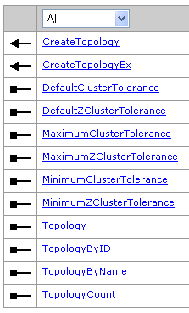
ITopologyContainer2 –拓扑关系
public ITopology CreateTopology (
  string Name,
  double ClusterTolerance,
  int maxGeneratedErrorCount,
  string ConfigurationKeyword );

Slide 54
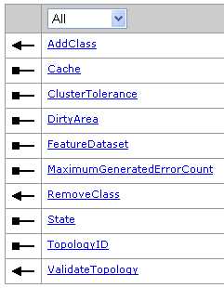
ITopology
public void AddClass
  (IClass classToAdd,
  double Weight,
  int XYRank,
  int ZRank,
  bool EventNotificationOnValidate );

Slide 55
//拷贝拓扑关系
  private void CreateTopology(IFeatureDataset sourceFeatureDataset, IFeatureDataset targetFeatureDataset)
  {
  IFeatureWorkspaceManage2 sourceWsManage = sourceWorkspace as IFeatureWorkspaceManage2;
  IFeatureWorkspace targetFeatureWorkspace = targetWorkspace as IFeatureWorkspace;
  ITopologyContainer toTopoContainer = (ITopologyContainer) targetFeatureDataset;
  ITopologyContainer fromTopoContainer = (ITopologyContainer)sourceFeatureDataset;
  int topoCount = fromTopoContainer.TopologyCount;
  ITopology fromTopology; ITopology toTopology;

Slide 56
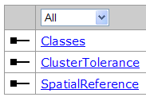
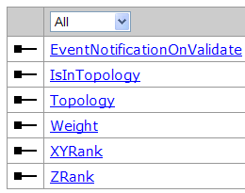
  for (int i = 0; i < topoCount; i++)
  { fromTopology = fromTopoContainer.get_Topology(i);
  string topologyName = (fromTopology as IDataset).Name;
  toTopology = toTopoContainer.CreateTopology(topologyName, toTopoContainer.DefaultClusterTolerance, -1, "");
  ITopologyProperties fromTopoProps = fromTopology as ITopologyProperties;
  IEnumFeatureClass fromTopoClasses = fromTopoProps.Classes;
  IFeatureClass fromFeatureClass = fromTopoClasses.Next();
  while (fromFeatureClass != null)
  { ITopologyClass fromTopoClass = fromFeatureClass as ITopologyClass;
  IFeatureClass toFeatureClass = targetFeatureWorkspace.OpenFeatureClass( ((IDataset)fromFeatureClass).Name);
  toTopology.AddClass(toFeatureClass, fromTopoClass.Weight, fromTopoClass.XYRank, fromTopoClass.ZRank, false);
  fromFeatureClass = fromTopoClasses.Next();
  }

Slide 57
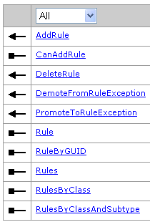
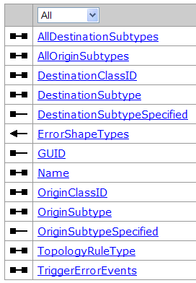
  ITopologyRuleContainer fromTopoRuleContainer = fromTopology as ITopologyRuleContainer;
  IEnumRule fromRules = fromTopoRuleContainer.Rules;
  IRule fromRule = fromRules.Next();
  ITopologyRuleContainer toTopoRuleContainer = toTopology as ITopologyRuleContainer;
  while (fromRule != null)
  { ITopologyRule fromTopoRule = fromRule as ITopologyRule;
  ITopologyRule topologyRule = new TopologyRuleClass();
  topologyRule.Name = fromTopoRule.Name;
  string fromOrigin = sourceWsManage.GetObjectClassNameByID(fromTopoRule.OriginClassID);
  IFeatureClass toOriginCls = targetFeatureWorkspace.OpenFeatureClass(fromOrigin);
  string fromDes = ……
  IFeatureClass toDesCls = targetFeatureWorkspace.OpenFeatureClass(fromDes);

Slide 58
  topologyRule.OriginClassID = toOriginCls.FeatureClassID;
  topologyRule.DestinationClassID = toDesCls.FeatureClassID;
  topologyRule.OriginSubtype = fromTopoRule.OriginSubtype;
  topologyRule.AllDestinationSubtypes = fromTopoRule.AllDestinationSubtypes;
  topologyRule.AllOriginSubtypes = fromTopoRule.AllOriginSubtypes;
  topologyRule.DestinationSubtype = fromTopoRule.DestinationSubtype;
  topologyRule.TopologyRuleType = fromTopoRule.TopologyRuleType;
  if (toTopoRuleContainer.get_CanAddRule(topologyRule))
  { toTopoRuleContainer.AddRule(topologyRule); }
  fromRule = fromRules.Next();
  } } }

Slide 59
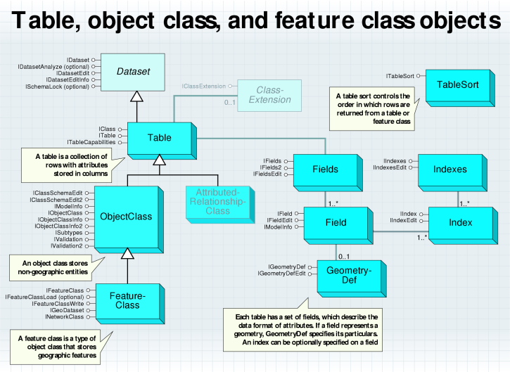
8.4 表、对象类和要素类

Slide 60
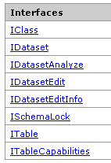
8.4.1 Table对象
从关系数据库的角度而言，Table对象代表了GeoDatabase里面的一张二维表，它是最简单的数据容器对象，存储的元素是Row对象，因此它也是一个数据集对象。
  Table是ObjectClass和FeatureClass的父类。

Slide 61
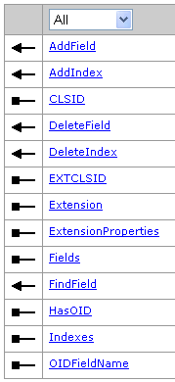
IClass接口
所有的Table类（包括Table，ObjectClass和FeatureClass）都实现了IClass接口，通过这个接口定义的属性和方法可以实现表对象的最一般的操作。
  IClass.Fields可以获得一个表的字段结构，IClass.HasOID属性则可以返回一个表是否有OID字段。而IClass.OIDFieldName属性返回OID字段的字段名。
  AddField用于给表对象添加一个字段、Addlndex用于给表添加一个索引。
  IClass.FindField方法可以通过一个字段的字段名获得它在表的字段集中的索引号。

Slide 62
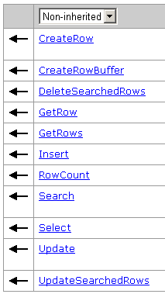
ITable接口
Table主要实现了 ITable接口，它继承自 IClass。这个接口定义的方法可以供用户查询、选择、插入、更新、删除表中的记录。
  public IRow GetRow (int OID );
  public ICursor GetRows (object oids, bool Recycling );
  The Insert method returns an ‘insert’ cursor that can be used to bulk insert rows. It offers significantly faster performance than multiple calls to CreateRow and Store for tables storing simple rows and simple features.

Slide 63
  public ICursor Search (IQueryFilter QueryFilter, bool Recycling );
  public ISelectionSet Select ( IQueryFilter QueryFilter, esriSelectionType selType, esriSelectionOption selOption, IWorkspace selectionContainer );
  public ICursor Update (IQueryFilter QueryFilter, bool Recycling );
  public void DeleteSearchedRows ( IQueryFilter QueryFilter );
  public void UpdateSearchedRows ( IQueryFilter QueryFilter, IRowBuffer buffer);

Slide 64
private void AddRow()
  {
  IWorkspaceFactory pWorkspaceFactory = new AccessWorkspaceFactoryClass();
  IFeatureWorkspace pWorkspace = pWorkspaceFactory.OpenFromFile(@"d:\temp\test.mdb", 0) as IFeatureWorkspace;
  ITable pTable = pWorkspace.OpenTable("test");
  IRow pRow = pTable.CreateRow();
  pRow.set_Value(1, "jack");
  pRow.set_Value(2, 20);
  pRow.Store();
  }

Slide 65
  IRow pRow = pTable.GetRow(1);
  pRow.set_Value(1, "jack");
  pRow.set_Value(2, 25);
  pRow.Store();

Slide 66
public void Update1Field(ITable table)
  {
  IQueryFilter queryFilter = new QueryFilterClass();
  queryFilter.WhereClause = "Pop1996 >= 10000";
  queryFilter.SubFields = "TERM";
  int termPosition = table.FindField("TERM");
  IRowBuffer rowBuffer = table.CreateRowBuffer();
  rowBuffer.set_Value(termPosition, "City");
  // Update the matching rows.
  table.UpdateSearchedRows(queryFilter, rowBuffer);
  }

Slide 67
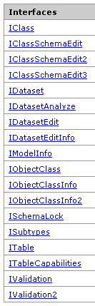
8.4.2 ObjectClass对象
ObjectClass（对象类）是 Table对象的子类，它也是由 Row组成的表；是Table的一种扩展，它就是一张“智能化”的表，拥有属性和行为。
一个对象类和其他对象类之间可以存在任意数目的关系（Relationship），这些关系可以用于控制对象的行为。
一个对象类可以使用一个字段将它自身划分为几个子类（Subtypes）。

Slide 68
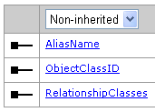
IObjectClass接口
所有的对象类都支持IObjectClass接口，它是从IClass接口继承而来的。
  IObjectClass::AliasName属性可以返回对象类的别名，如果一个对象类没有设置别名属性，那么这个别名将和对象类的Name属性一样。
  IObjectClass::ObjectClassID属性则可以返回这个对象类的 OID值。其实一个没有被注册的对象类也是有 OID值的，但是这个值总是为-1，而且通过 IClass::HasOID属性来查询的时候，返回值为false。
  IObjectClass:: RelationshipClasses 列出了该对象类参与的关系类（按关系类的角色： origin, destination, or any）。
    public IEnumRelationshipClass get_RelationshipClasses (esriRelRole role);

Slide 69
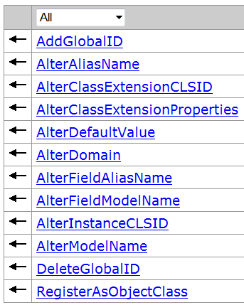
IClassSchemaEdit3接口
IClassSchemaEdit、IClassSchemaEdit2和IClassSchemaEdit3接口都可以用于修改一个对象类的属性。如对象类的别名，对象类某个字段的缺省值、值域，改变对象类字段的别名等。
使用IClassschemaEdit中的方法时，用户必须取得这个对象类的完全控制权，以免在修改的过程中有别的程序使用这个对象类，为此需要使用ISchemaLock接口来给数据集（对象类也是一个数据集）设置一个独占型的锁定。

Slide 70
private void ChangeSchema()
  { IFeatureWorkspace pFeatWorkspace = pWorkspace as IFeatureWorkspace;
  IClassSchemaEdit pOcSchemaEdit = pFeatWorkspace.OpenFeatureClass("Parcels") as IClassSchemaEdit;
  ISchemaLock pSchLock = pOcSchemaEdit as ISchemaLock;
  pSchLock.ChangeSchemaLock(esriSchemaLock.esriExclusiveSchemaLock);
  pOcSchemaEdit.AlterFieldAliasName("Res", "ResOrNon");
  pSchLock.ChangeSchemaLock(esriSchemaLock.esriSharedSchemaLock);
  }

Slide 71
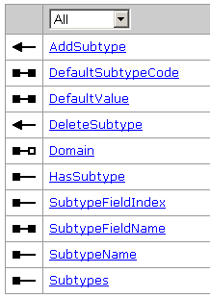
ISubtypes接口
ISubtypes接口用于管理和查询对象类的子类、属性域（Domain）和缺省值（default value）。

Slide 72
  public void AddSubtype ( int SubtypeCode, string SubtypeName);
  public int DefaultSubtypeCode {get; set;}
  public object get_DefaultValue ( int SubtypeCode, string FieldName);
  public void set_DefaultValue ( int SubtypeCode, string FieldName, object Value);
  public IDomain get_Domain ( int SubtypeCode, string FieldName);
  public void set_Domain ( int SubtypeCode, string FieldName, IDomain Domain);
  public string get_SubtypeName ( int SubtypeCode);
  public IEnumSubtype Subtypes {get;}

Slide 73
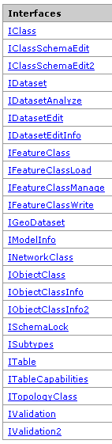
8.4.3 FeatureClass对象
FeatureClass（要素类）是可以存储空间数据的对象类，它是ObjectClass的扩展。
在一个要素类中的所有的要素都使用同样的字段结构，要素类与表、对象类的最大的区别在于它拥有一个几何字段，即Shape字段，用于存储要素的几何信息，这使得用户可以在地图上看到一个要素的形状和位置。

Slide 74
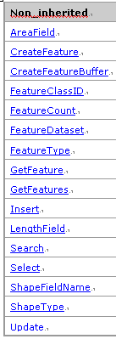
IFeatureClass接口
The IFeatureClass interface inherits from the IObjectClass and IClass interfaces .
  ShapeFieldName属性可以返回要素类的几何字段的名称，AreaField和LengthField则可以返回要素类中用于存储要素面积和长度的字段对象。
  ShapeType返回的是 Shape字段的类型，即要素类存储的是什么类型的几何对象。IFeatureClass::FeatureType可以让程序员知道要素类的类型，如简单要素类、标注类、注记类还是复杂要素类等。
  FeatureClassID返回的是要素类在地理数据库中的唯一标识符，它和IObiectClass.ObiectClassID属性是一样的。

Slide 75
  使用 Select方法可以在一个要素类中得到要素选择集，而获得的要素选择集的数目和种类取决于使用的过滤器对象（QueryFilter）。
  CreateFeature方法可以新建一个新的要素对象，用户在新建一个Feature对象后，需要对它的值进行设定，然后使用IFeature::Store方法将新的要素存储到要素类中去。CreateFeatureBuffer方法则用于产生一个FeatureBuffer对象，它并不是一个真正的要素，而是一个暂时存在的对象，它需要使用“插入”游标，将新建的“缓冲要素”保存到要素类中去。

Slide 76
private void CreateFeatureClassInThisDataset(IFeatureClass sourceFeatureClass, IFeatureDataset targetFeatureDataset)
public IFeatureClass CreateFeatureClass ( string Name, IFields Fields, UID CLSID, UID EXTCLSID, esriFeatureType FeatureType, string ShapeFieldName, string ConfigKeyword );
  Use the CreateFeatureClass method in the IFeatureDataset interface to create a new feature class within a FeatureDataset. The arguments to this method are the same as to the CreateFeatureClass method in IFeatureWorkspace.
  The optional CLSID parameter is used to specify what GUID to use to instantiate the object representing a feature in that FeatureClass. If "Nothing" is passed in for the CLSID, the GeoDatabase will use the CLSID corresponding to esriGeoDatabase.Feature. This is OK in most instances.
  The optional EXTCLSID parameter specifies the GUID to use to instantiate the object representing the FeatureClassExtension.

Slide 77
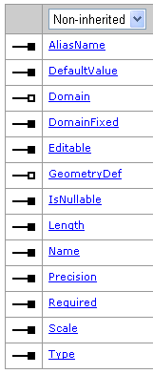
private void CreateFeatureClassInThisDataset(IFeatureClass sourceFeatureClass, IFeatureDataset targetFeatureDataset)
  { IFields fields = sourceFeatureClass.Fields;
  if (fields == null) return;
  IFieldsEdit fieldsEdit = (IFieldsEdit)fields;
  //定义几何字段
  IField fieldUserDefined = new FieldClass ();
  IFieldEdit fieldEdit = (IFieldEdit)fieldUserDefined;
  IGeometryDef geometryDef = new GeometryDefClass();
  IGeometryDefEdit geometryDefEdit = (IGeometryDefEdit)geometryDef;
  geometryDefEdit.GeometryType_2 = sourceFeatureClass.ShapeType;
  geometryDefEdit.GridCount_2 = 1;
  geometryDefEdit.set_GridSize(0, 0);
  geometryDefEdit.HasM_2 = bHasM;
  geometryDefEdit.HasZ_2 = bHasZ;

Slide 78
  // Set standard field properties.
  fieldEdit.Name_2 = "SHAPE";
  fieldEdit.Type_2 = esriFieldType.esriFieldTypeGeometry;
  fieldEdit.GeometryDef_2 = geometryDef;
  fieldEdit.IsNullable_2 = true;
  fieldEdit.Required_2 = true;
  fieldsEdit.set_Field(fields.FindField("SHAPE"), fieldUserDefined);
  UID CLSID = new UIDClass();
  CLSID.Value = "esriGeoDatabase.Feature";
  string featureClassName = ((IDataset)sourceFeatureClass).Name;
  IFeatureClass targetClass = targetFeatureDataset.CreateFeatureClass(featureClassName, fields, CLSID, null, esriFeatureType.esriFTSimple, "Shape", "");
  //设置要素类子类型
  SetSubtypes(sourceFeatureClass, targetClass);
  }

Slide 79
//拷贝要素类的子类型定义
  private void SetSubtypes(IFeatureClass fromFeatureClass, IFeatureClass toFeatureClass)
  { IWorkspaceDomains targetWorkspaceDomains = (IWorkspaceDomains)targetWorkspace;
  ISubtypes toSubtypes = (ISubtypes)toFeatureClass;
  ISubtypes fromSubtypes = (ISubtypes)fromFeatureClass;
  IFields fromFields = fromFeatureClass.Fields
  IEnumSubtype fromEnumSubtype;
  string subtypeFieldName;
  int subtypeCode; string subtypeName;
  IDomain fromDomain;

Slide 80
  if (fromSubtypes.HasSubtype)
  { fromEnumSubtype = fromSubtypes.Subtypes;
  subtypeFieldName = fromSubtypes.SubtypeFieldName;
  toSubtypes.SubtypeFieldName = subtypeFieldName;
  subtypeName = fromEnumSubtype.Next(out subtypeCode);
  while (subtypeName != null)
  { toSubtypes.AddSubtype(subtypeCode, subtypeName);
  for (int i=0;i<fromFields.FieldCount;i++)
  { string fieldName = fromFields.get_Field(i).Name;
  fromDomain = fromSubtypes.get_Domain(subtypeCode, fieldName );
  if (fromDomain != null)
  toSubtypes.set_Domain(subtypeCode, fieldName , targetWorkspaceDomains.get_DomainByName(fromDomain.Name));}
  subtypeName = fromEnumSubtype.Next(out subtypeCode);
  }
  }
  }
public IDomain get_Domain ( int SubtypeCode, string FieldName );
public void set_Domain (int SubtypeCode, string FieldName, IDomain Domain );

Slide 81
private void CopyFeatureClass( IFeatureClass sourceClass, IFeatureClass targetClass)
  { IFeatureBuffer targetFeatureBuffer = targetClass.CreateFeatureBuffer();
  IFeatureCursor targetFeatureCursor = targetClass.Insert(true);
  IFields sourceFields = sourceClass.Fields;
  IFields targetFields = targetClass.Fields;
  IFeatureCursor sourceFeatureCursor = sourceClass.Search(null, false);
  IFeature sourceFeature = sourceFeatureCursor.NextFeature();
  int j = 0;
Create a feature buffer that can be used with an insert cursor.
Insert creates an insert cursor on the feature class which can be used to insert new features into it.

Slide 82
  while (sourceFeature != null)
  {
  IGeometry geometry = sourceFeature.ShapeCopy;
  if (geometry == null) goto nextFeature;
  if (geometry is ITopologicalOperator2)
  { ITopologicalOperator2 topo = geometry as ITopologicalOperator2;
  topo.IsKnownSimple_2 = false;
  topo.Simplify();
  }
  IZAware za = geometry as IZAware;
  za.ZAware = bHasZ;
  IMAware ma = geometry as IMAware;
  ma.MAware = bHasM;
  targetFeatureBuffer.Shape = geometry;

Slide 83
  for (int i = 0; i < targetFields.FieldCount; i++)
  { IField field = new FieldClass(); field = targetFields.get_Field(i);
  if (field.Type == esriFieldType.esriFieldTypeOID) continue;
  if (field.Type == esriFieldType.esriFieldTypeGeometry) continue;
  if (field.Name == "Shape_Length") continue;
  if (field.Name == "Shape_Area") continue;
  int fieldIdx = sourceFields.FindField(field.Name);
  object fieldValue = sourceFeature.get_Value(fieldIdx);
  targetFeatureBuffer.set_Value(i, fieldValue);
  }
  targetFeatureCursor.InsertFeature(targetFeatureBuffer);
  sourceFeature = null; j++;
  nextFeature: sourceFeature = sourceFeatureCursor.NextFeature();
  }
  targetFeatureCursor.Flush();
  }

Slide 84
8.4.4 字段集与字段
字段集（Fields）是表的列（Column）属性的集合。一张表必须有一个字段集，而一个字段集中至少有一个字段（Field） 。字段集是一个组件类。在新建一个字段后，必须将它加入到一个字段集中供新建的表或要素类使用。
设置字段集的过程包括设定字段集中字段（Field）的类型（Type）和值域（Domain），缺省值，别名（Alias）和是否允许为空（Allow nulls）等属性。

Slide 85
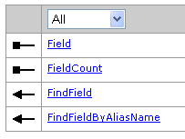
IFields接口
字段集是与一个表相关联的，如果需要获取一个表对象的字段集，可以使用ITable::Fields属性来实现。程序员使用IFields接口定义的属性和方法，可以非常容易地得到字段集中的某个字段，继而获得某个特定字段的值。
IFields有两个属性，其中一个是Field(index)，它通过传入不同的字段索引值可以返回某个字段，如：
  IField pField = pFields.get_Field(0);
而IFields::FieldCount属性可以返回字段集合的字段数目。
IFields定义了两种方法，一种是FindField，另一种是FindFieldByAliasName，前者是根据字段名、后者是根据字段别名找到字段在字段集中的索引号。

Slide 86
下面是获取一个名为“City_name”字段的代码段：
  IFields pFields = pFeatClass.Fields;
  int i = pFields.FindField("City_name");
  IField pField = pFields.get_Field(i);

Slide 87
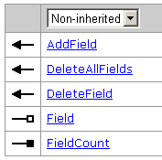
IFieldsEdit接口
字段集中的字段需要能够修改、更新和删除，实现这些要求的方法由IFieldsEdit接口定义，这个接口从 IFields继承而来。
IFieldsEdit::AddField方法，可以添加一个新的字段到字段集中。当需要修改一个表或者要素类的结构时，这个方法非常有用。DeleteAllFields方法可以一次删除表中所有的字段。

Slide 88
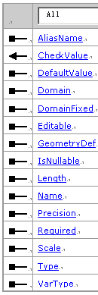
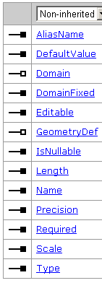
IField与IFieldEdit接口

Slide 89
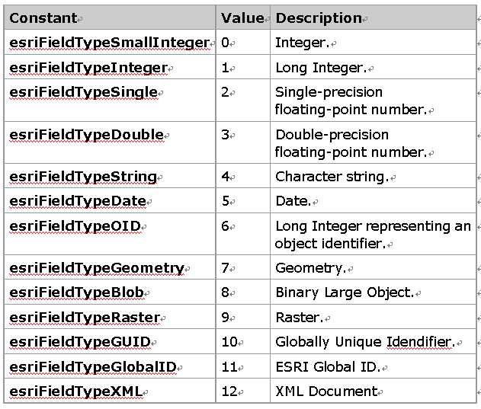
esriFieldType Constants

Slide 90
private ITable CreateTable( IFeatureWorkspace pFeatWorkspace, string strName )
  { IFields pFields = new FieldsClass();
  IFieldsEdit pFieldsEdit = pFields as IFieldsEdit;
  pFieldsEdit.FieldCount_2 = 2; //设定字段数目
  IField pField = new FieldClass(); IFieldEdit pFieldEdit = pField as IFieldEdit;
  pFieldEdit.Name_2 = "OBJECTID"; pFieldEdit.AliasName_2 = "FID";
  pFieldEdit.Type_2 = esriFieldType.esriFieldTypeOID;
  pFieldsEdit.set_Field(0, pField);
  pField = new FieldClass(); pFieldEdit = pField as IFieldEdit;
  pFieldEdit.Length_2 = 30; pFieldEdit.Name_2 = "Owner";
  pFieldEdit.Type_2 = esriFieldType.esriFieldTypeString;
  pFieldsEdit.set_Field(1, pField);
  ITable pTable = pFeatWorkspace.CreateTable(strName, pFields, null, null, "");
  return pTable;
  }
public ITable CreateTable ( string Name, IFields Fields, UID CLSID, UID EXTCLSID, string ConfigKeyword );

Slide 91
private void AddFieldToFeatureClass()
  { IWorkspaceFactory pWSF = new AccessWorkspaceFactoryClass();
  IFeatureWorkspace pWS = pWSF.OpenFromFile(@"d:\temp\test.mdb", 0) as IFeatureWorkspace;
  IFeatureClass pFeatClass = pWS.OpenFeatureClass("parcels");
  IField pField = new FieldClass();
  IFieldEdit pFieldEdit = pField as IFieldEdit;
  pFieldEdit.Type_2 = esriFieldType.esriFieldTypeDouble;
  pFieldEdit.Name_2 = "tax";
  pFeatClass.AddField(pField); }

Slide 92
8.4.5 与字段相关的对象
  设计几何字段
  设置表的索引
  使用子类型
  使用属性域

Slide 93
8.4.5.1 几何字段的设计
几何字段用于存储要素的几何形状，几何字段没有缺省值。
设计一个几何字段的时候，有一个属性是必须设置的，即 IField::GeometryDef。它是一个 GeometryDef对象，用于预定义一个几何字段的几何属性。GeometryDef对象的两个接口分别是IGeometryDef和IGeometryDefEdit，由于两个接口定义的属性都是可读写的，如 GeometryType为可读，GeometryType_2为可写。
IGeometryDef::GeometryType属性用于设置几何字段的几何类型，如点、点集、多边形、环等；SpatialRefrence属性则用于设置几何字段的空间参考。对于一个几何字段而言，这两个属性是必需的。

Slide 94
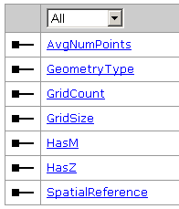
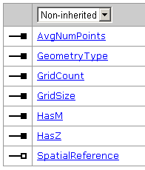
IGeometryDef和IGeometryDefEdit

Slide 95
private void DefineGeometryField(ISpatialReference pSpatRef)
  {
  IGeometryDef pGeoDef = new GeometryDefClass();
  IGeometryDefEdit pGeoDefEdit = pGeoDef as IGeometryDefEdit;
  pGeoDefEdit.AvgNumPoints_2 = 5;
  pGeoDefEdit.GeometryType_2 = esriGeometryType.esriGeometryPolyline;
  pGeoDefEdit.GridCount_2 = 2;
  pGeoDefEdit.set_GridSize(0, 200); pGeoDefEdit.set_GridSize(1, 500);
  pGeoDefEdit.HasM_2 = false; pGeoDefEdit.HasZ_2 = true;
  pGeoDefEdit.SpatialReference_2 = pSpatRef;
  IField pField = new FieldClass();
  IFieldEdit pFieldEdit = pField as IFieldEdit;
  pFieldEdit.Name_2 = "SHAPE";
  pFieldEdit.Type_2 = esriFieldType.esriFieldTypeGeometry;
  pFieldEdit.GeometryDef_2 = pGeoDef; pFieldEdit.IsNullable_2 = true;
  }

Slide 96
8.4.5.2 索引集和索引
索引集（Indexes）对象和字段集对象相似，它用于管理被设置为索引的字段，IIndexes接口用于管理索引集对象，如IIndexes::index属性可以按照索引值得到一个表中的某个特定的索引。
索引对象代表了一个表的索引。一个要素类存在两种形式的索引：空间索引和属性索引。空间索引存在一个要素类的几何字段中，当一个要素类被创建的时候，系统会自动给这个要素类创建一个空间索引。对于GeoDatabase而言，它也会给要素类自动建立一个属性索引，这个索引是基于OID字段的。
Index对象支持IIndex接口和IIndexEdit接口，使用这两个接口可以产生一个索引并设置它的属性。

Slide 97
public void IIndexes_FindIndexesByFieldName_Example(IFeatureClass featureClass, string nameOfField)
  { IIndexes indexes = featureClass.Indexes;
  Console.WriteLine("The feature class has an index count of: {0}", indexes.IndexCount);
  int indexPosition;
  indexes.FindIndex("Temp_Index", out indexPosition);
  Iindex index = indexes.get_Index(indexPosition);
  //or
  IEnumIndex enumIndex = indexes.FindIndexesByFieldName(nameOfField);
  index = enumIndex.Next();
  while (index != null)
  { if (index.Name == "Temp_Index")
  { featureClass.DeleteIndex(index); break; }
  index = enumIndex.Next();
  }
  }

Slide 98
public void AddIndexToFeatureClass(IFeatureClass featureClass, String indexName, String nameOfField)
  { int fieldIndex = featureClass.FindField(nameOfField);
  if (fieldIndex == -1) { }
  IFields featureClassFields = featureClass.Fields;
  IField field = featureClassFields.get_Field(fieldIndex);
  IFields fields = new FieldsClass(); IFieldsEdit fieldsEdit = (IFieldsEdit)fields;
  fieldsEdit.FieldCount_2 = 1; fieldsEdit.set_Field(0, field);
  IIndex index = new IndexClass(); IIndexEdit indexEdit = (IIndexEdit)index;
  indexEdit.Fields_2 = fields; indexEdit.IsAscending_2 = false;
  indexEdit.IsUnique_2 = false; indexEdit.Name_2 = indexName;
  ISchemaLock schemaLock = (ISchemaLock)featureClass;

Slide 99
  try { schemaLock.ChangeSchemaLock(esriSchemaLock.esriExclusiveSchemaLock);
  featureClass.AddIndex(index);
  }
  catch (COMException comExc)
  { //提示出错信息 }
  finally { schemaLock.ChangeSchemaLock(esriSchemaLock.esriSharedSchemaLock); }
  }

Slide 100
8.4.5.3 子类型
子类型（Subtypes）是一种用于给要素类或者对象类中的要素或对象分组的方式。通过给定不同子类的不同的缺省值和有效性规则，用户可以定制要素类中不同子类要素的行为。
  如：在一个要素数据集中，有Land和building要素类，用户希望两个要素类之间的要素是满足严格的拓扑关系的，比如商业建筑必须在商业土地区内，工业建筑不能在居住土地区等。这时可以将一个Land的要素类分为三个子类——business、residential和industry；将building的要素也分为三种：business要素、residential要素和 industry要素。将两个要素类各自分成子类后，可以在地理数据集中建立拓扑关系，并用这些拓扑规则来保证要素类的设计要求。

Slide 101
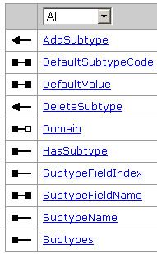
为了建立一个对象类的子类型和设置子类型字段的缺省值，程序员可以使用ISubtypes接口。

Slide 102
private void CreateSubtypes()
  { IWorkspaceFactory pFact = new FileGDBWorkspaceFactoryClass();
  IFeatureWorkspace pFeatws = pFact.OpenFromFile(@"d:\temp\test.gdb", 0) as IFeatureWorkspace;
  IFeatureClass pFeatcls = pFeatws.OpenFeatureClass("parcels");
  ISubtypes pSubType = pFeatcls as ISubtypes;
  pSubType.SubtypeFieldName = "Res";
  pSubType.AddSubtype(1, "Non_Residential");
  pSubType.AddSubtype(2, "Residential");
  pSubType.DefaultSubtypeCode = 1;
  pSubType.set_DefaultValue(1, "ZONING_S", "B");
  pSubType.set_DefaultValue(2, “ZONING_S”,“R”);
  //子类代码，字段名，值
  }
“ parcels”要素类分为2个子类：
Non_Residential ，子类代码为1；
Residential ，代码值为2。
public void set_DefaultValue ( int SubtypeCode, string FieldName, object Value );

Slide 103
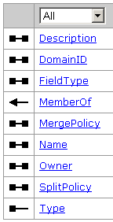
8.4.5.4 属性域
Domain （属性域）是一个抽象类，它可以用于限制一个对象类或一个要素类的某个字段的允许值。值域可以用于探测一个字段值的有效性，它是子类的基础。
属性域与一个工作空间相关，因而一个值域可以给多个字段使用。在ArcObjects中可以通过IWorkspaceDomains.AddDomain来添加一个属性域对象。
RangeDomain和CodedValueDomain是Domain的子类，它们是组件类，并且都支持lDomain接口。

Slide 104
Rangedomain是范围值域对象，它确定某个字段的值在一个范围内，这个对象规定的值只能是数值型或日期型，如考试的分数在0到100的范围内，日期在2005-1-1到2006-1-1的范围内。IRangeDomain接口规定了范围的最大和最小值属性。

Slide 105
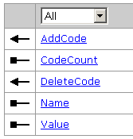
CodedValueDomain是代码值域对象，它是一个“值-名称”对象的集合，它用于确定一个字段所有可能的取值。代码值域一般都是字符类型。
  如用户将土地分为三种使用类型(“工业土地”、“农业土地”、“居住土地’’)后，这个土地要素类中的类型字段可以出现的值就是用户规定的三种，而不能出现别的。
ICodedValueDomain规定了代码值域对象的特定的属性和方法，如AddCode方法可以用于添加一个“值-名称’’对象，而使用Name和Value可以通过一个索引值来得到一个“值-名称”对象。

Slide 106
//拷贝数据库的属性域
  public void CopyDomains(IWorkspace sourceWorkspace, IWorkspace targetWorkspace)
  { IWorkspaceDomains targetWorkspaceDomains = (IWorkspaceDomains)targetWorkspace;
  IWorkspaceDomains sourceWorkspaceDomains = (IWorkspaceDomains)sourceWorkspace;
  IEnumDomain sourceDomains = sourceWorkspaceDomains.Domains;
  if (sourceDomains == null) return;
  IDomain sourceDomain = sourceDomains.Next();
  IDomain targetDomain = null;

Slide 107
  while (sourceDomain != null)
  { if (sourceDomain is IRangeDomain)
  { IRangeDomain rangeDomain = new RangeDomainClass();
  rangeDomain.MinValue = (sourceDomain as IRangeDomain).MinValue;
  rangeDomain.MaxValue = (sourceDomain as IRangeDomain).MaxValue;
  targetDomain = rangeDomain as IDomain; }
  if (sourceDomain is ICodedValueDomain)
  { ICodedValueDomain sourceCodedDomain =sourceDomain as ICodedValueDomain;
  ICodedValueDomain codedDomain = new CodedValueDomainClass();
  for (int i = 0; i < sourceCodedDomain.CodeCount; i++) { codedDomain.AddCode(sourceCodedDomain.get_Value(i),sourceCodedDomain.get_Name(i)); }
  targetDomain = codedDomain as IDomain; }

Slide 108
  if (targetDomain == null) return;
  targetDomain.Name = sourceDomain.Name;
  targetDomain.FieldType = sourceDomain.FieldType;
  targetDomain.MergePolicy = sourceDomain.MergePolicy;
  targetDomain.SplitPolicy = sourceDomain.SplitPolicy;
  targetWorkspaceDomains.AddDomain(targetDomain);
  sourceDomain = sourceDomains.Next();
  }
  }

Slide 109
private void AddDomain()
  { IWorkspaceFactory pWorkspaceFactory = new AccessWorkspaceFactoryClass();
  IWorkspace pWorkspace = pWorkspaceFactory.OpenFromFile(@"d:\temp\test.mdb", 0);
  IWorkspaceDomains pWorkspaceDomains = pWorkspace as IWorkspaceDomains;
  IRangeDomain pRange = new RangeDomainClass();
  pRange.MinValue = 9.0; pRange.MaxValue = 600000.0;
  IDomain pDomain = pRange as IDomain;
  pDomain.Name = "Area constraint";
  pDomain.FieldType = esriFieldType.esriFieldTypeDouble;
  pDomain.Description = "Constrains the area Of buildings";
  pDomain.MergePolicy = esriMergePolicyType.esriMPTAreaWeighted;
  pDomain.SplitPolicy = esriSplitPolicyType.esriSPTGeometryRatio;
  pWorkspaceDomains.AddDomain(pDomain);

Slide 110
  ICodedValueDomain pCodeValue = new CodedValueDomainClass();
  pCodeValue.AddCode("RES", "Residential");
  pCodeValue.AddCode("COM", "Commercial");
  pCodeValue.AddCode("IND", "Industrial");
  pCodeValue.AddCode("BLD", "Building");
  //QI到IDomain，设置属性
  IDomain pDomainCodeValue = pCodeValue as IDomain;
  pDomainCodeValue.FieldType = esriFieldType.esriFieldTypeString;
  pDomainCodeValue.Name = "Building types";
  pDomainCodeValue.Description = "Valid building type codes";
  pDomainCodeValue.MergePolicy = esriMergePolicyType.esriMPTDefaultValue;
  pDomainCodeValue.SplitPolicy = esriSplitPolicyType.esriSPTDuplicate;
  //添加到工作空间
  pWorkspaceDomains.AddDomain(pDomainCodeValue);
  }

Slide 111
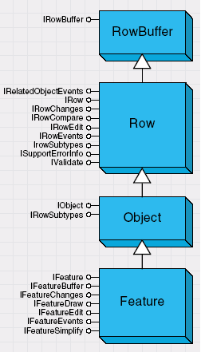
8.5 ROW，Object 和 Feature 对象
表、对象类和要素类是一个数据集，作为它们的组成部分，Row(行)、Object(对象)和Feature(要素)就是最小的数据单元。它们的物理组成就是地理数据库中的一行记录。
在ArcObjects开发中，插入、更新和删除数据库中的一条记录是非常普遍的操作。

Slide 112

8.5.1 RowBuffer和Row对象
RowBuffer(缓冲行)对象可以以一个行(Row)对象的状态出现，但是它并不是一个对象实体，即它是临时存在内存中的对象。这个对象主要被使用在一个插入游标的InsertRow方法中，作为一个参数使用。用户可以使用ITable::CreateRowBuffer方法来获得一个缓冲行对象。
IRowBuffer接口用于获得RowBuffer对象的属性，如Fields用于获得缓冲行对象的字段集，而Value属性可以通过字段的索引值得到某个字段的值，通常用于被设置字段值。

Slide 113
Row是一个组件类对象，它代表了一个表对象中的一行记录。程序员可以根据一个表的游标来获得Row对象，如ICursor::Row，当然，用户可以根据它的OID值来获得，如ITable::GetRow。
ArcObjects中一般都使用ITable::CreateRow来产生一个新的Row对象，在得到这个对象后，需要给这个对象不同字段的值进行设置，Row对象也有字段集，而且这个字段集和它所属于的表的字段集是一样的，因而用户还需要通过IFields对象的各种方法和属性来获得某个具体的字段，然后赋值给它。

Slide 114
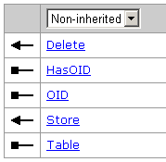
Row对象主要支持IRow接口，这个接口从IRowBuffer继承而来。
  int i = pTable.FindField("Name");
  //添加一条记录
  IRow pRow = pTable.CreateRow();
  pRow.set_Value(i, "esri");
  pRow.Store();
  //更新一条记录
  pRow.set_Value(i,"esrichina");
  pRow.Store();
  //删除一条记录
  pRow.Delete();

Slide 115
8.5.2 Object和Feature对象
ObjectClass对象是Object(对象)的集合， Object代表了一个具有属性和行为的实体对象。在地理数据库中，对象类其实也是一张表，所以Object对象也就是表中的一条记录。
IObject接口是Object对象的主要接口，它和IRow接口非常相似，且是从IRow继承的。IObject::Class属性可以获得对象的容器--对象类。

Slide 116
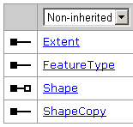
Feature(要素)是要素类中的一条记录，是从对象派生出来的既具有属性和行为，而且还能保存空间数据的对象。要素中的几何形体对象定义了要素类的类型。一个要素中可能保存的几何形体有点、点集、多边形和多义线。
Feature对象的主要接口是IFeature，它从IRowBuffer、 IRow和IObject继承而来，定义了要素对象特有的属性和方法。
IFeatureBuffer接口从IRowBuffer继承而来，并增加了一个Shape属性。

Slide 117
private void AddFeatureToFeatureClass( IFeatureClass pFeatClass, IGeometry pGeom )
  { IFeatureCursor pFeatCur = pFeatClass.Insert(true);
  IFeatureBuffer pFeatBuf = pFeatClass.CreateFeatureBuffer();
  IPolygon pPolygon = pGeom as IPolygon;
  IFields pFlds = pFeatClass.Fields; IField pFld ;
  for (int i = 1 ; i <= pFlds.FieldCount - 1; i++)
  { pFld = pFlds.get_Field(i);
  if (pFld.Type == esriFieldType.esriFieldTypeGeometry) pFeatBuf.set_Value(i,pGeom);
  else {
  if (pFld.Type == esriFieldType.esriFieldTypeInteger) pFeatBuf.set_Value(i, 0);
  if (pFld.Type == esriFieldType.esriFieldTypeDouble ) pFeatBuf.set_Value(i,0.0);
  if (pFld.Type == esriFieldType.esriFieldTypeSmallInteger) pFeatBuf.set_Value(i, 0);
  if (pFld.Type == esriFieldType.esriFieldTypeString) pFeatBuf.set_Value(i,"noname");
  }
  }
  pFeatCur.InsertFeature(pFeatBuf);
  }

Slide 118
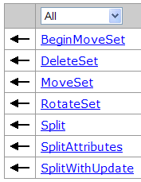
IFeatureEdit、 IFeatureEdit2接口定义的方法可以用于编辑单个的要素或者多个要素组成的要素集。
这个接口定义的MoveSet、RotateSet和IRow::DeleteSet方法既可以使用在单个要素上，也可以使用在多个要素组成的要素集上。
IFeatureEdit ::Split和IFeatureEdit ::SplitAttributes操作是使用在一个单一的要素上，前者可以通过一个或多个点分割多义线，或者使用多义线分割多边形。在分割后，新的要素会产生，而旧的要素会被删除掉。在分割一个或者多个要素时，用户需要通过一定的机制来分割要素的属性字段中的值，SplitAttributes方法将会执行这个过程，而属性分割机制是由字段的值域来决定的。但程序员并不需要在Split要素后执行SplitAttributes方法，因为后者会自动执行。

Slide 119
SplitPolygonFeatures.cs

Slide 120
8.5.3 更新要素
在GIS数据库中使用GeoDatabase模型更新一个要素的数据，就如同在普通数据库中更新一行记录一样方便。ArcObjects提供了多种方法：如IFeature::Store和IFeatureClass::Update都可以达到目的，但前一种方法一次只能够改变一个要素的值，而后者可以一次更新多个要素的值。

Slide 121
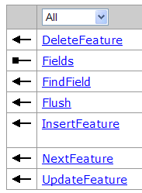
public void UpdateTypeValues(IFeatureClass featureClass)
  { IQueryFilter queryFilter = new QueryFilterClass();
  queryFilter.WhereClause ="Type = 'COM'";
  queryFilter.SubFields = "FID, Type";
  IFeatureCursor featureCursor = featureClass.Update(queryFilter, false);
  IFields fields = featureCursor.Fields;
  int fieldIndex = fields.FindField("Type");
  IFeature feature = null;
  while ((feature = featureCursor.NextFeature()) != null)
  { Console.WriteLine("The old type: {0}", feature.get_Value(fieldIndex));
  feature.set_Value(fieldIndex, "ABC");
  featureCursor.UpdateFeature(feature);
  Console.WriteLine("The new type: {0}", feature.get_Value(fieldIndex));}
  Marshal.ReleaseComObject(featureCursor);}

